Slide 1
Predicting Suicide Risk in U.S. High School Students Using Machine Learning
Group 1: Kathy Liu,Xianhui Fu,Ivy Liu,Ziren Zhou

Slide 2
Introduction
Background
Adolescent suicide is a serious public health issue influenced by multiple factors, including mental health, substance use, experiences of violence, and daily habits.
Research Objective
Predict high-risk behaviors among adolescents, particularly suicidal tendencies, and explore key influencing factors.
Methodology
The 2023 Youth Risk Behavior Surveillance System (YRBSS) provides the latest national data on health-related behaviors among U.S. high school students.
Utilize machine learning techniques to analyze the data and identify suicide risk patterns.

Slide 3
Why Does It Matter?
Can we predict which high school students are at risk of suicidal thoughts or behaviors based on their lifestyle, mental health, and experiences?
· Teen suicide is a serious
· Early warning can save lives
· Traditional methods miss key patterns

Slide 4
Literature Review
Suicide has become the second leading cause of death among adolescents in the United States.
9% of high school students have attempted suicide.
Demographic Factors
Gender: The suicide rate among male adolescents is higher than that of females, but females have a higher suicide attempt rate.
Age: aged 15-29
Race: Non-white adolescents, especially Black and Hispanic youth
Geographic and Spatial Factors
Urban-Rural Differences: Suicide rates in rural areas are typically higher than in urban areas.
Geographical Regions: coastal and mountainous regions
Population Density: Low-density areas have higher suicide rates than high-density areas
Psychological and Social Factors
Mental Health Issues: Depression, anxiety, and mental illnesses
Family Factors:
Single-parent households or family
Childhood trauma and parental neglect
Social Isolation and Interpersonal Relationships
Social isolation, lack of social support, and school bullying
LGBTQ+

Slide 5
Data description
Youth Risk Behavior Surveillance System (YRBSS)
Established in 1991 by Center for Disease Control and Prevention (CDC).
Primary goal is to understand and track adolescent health-risk behaviors.
The 2023 national Youth Risk Behavior Survey (YRBS) Data
Free and open to public
Uses a three-stage cluster sample design to produce a representative sample of 9th through 12th grade students.
A Weighting factor was applied to each student record to adjust for nonresponse and the oversampling of Black and Hispanic students in the sample.
Key categories of health-risk behaviors
Risky behaviors leading to unintentional injuries and violence (e.g., seatbelt use, weapon carrying, bullying)
Substance use (e.g., tobacco, alcohol, and drug use)
Sexual behaviors
Unhealthy dietary behaviors
Inadequate physical activity & Obesity and weight-related health risks
Suicide

Slide 6
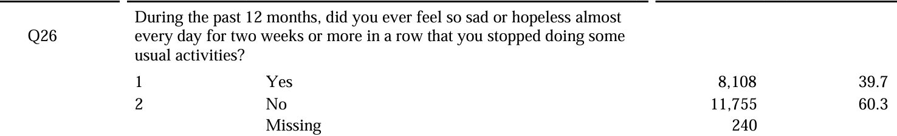
Data Processing
Original Data comes in numerical records of the respondents’ answer to each question.
Yes/No questions are recorded as: Yes=1, No=2
Categorical questions are recorded with numbers to represent option titles.
A=1, B=2, C=3, etc.
True categorical questions that does not represent levels ((e.g., main source of alcohol) are kept as it is.
Foe Yes/No questions, records are transformed into Yes=1, No=0 for clarity.

Slide 7
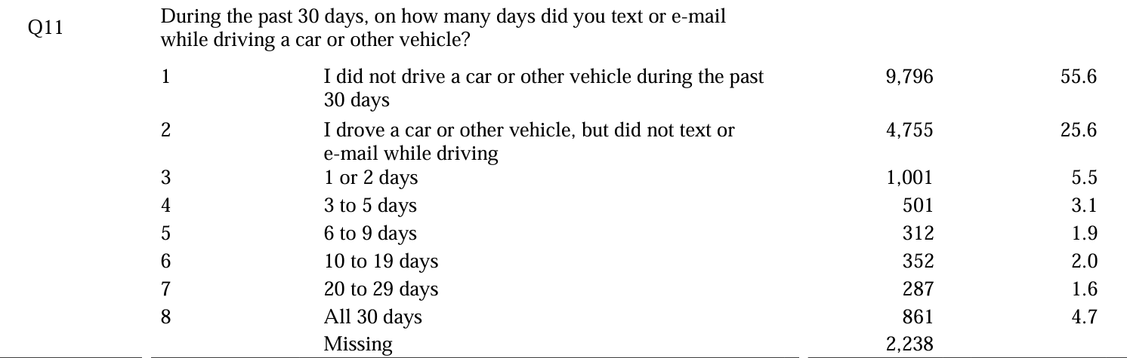
Data Processing
Categorical questions are transformed when:
The first option does not represent one of the levels described in the other options.
0=did not do the described action in question
actual frequency/intensity levels starting at the lowest level 1 to the highest

Slide 8
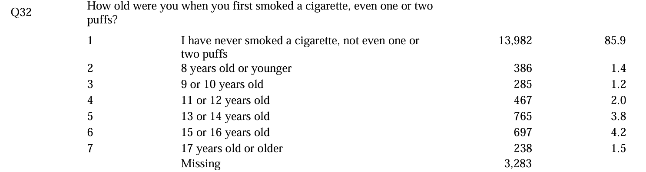
Data Processing
Categorical questions are transformed when:
The first option does not represent one of the levels described in the other options.
The levels can be transformed to represent the true option levels (if option describes a range, then the average will be taken).

Slide 9
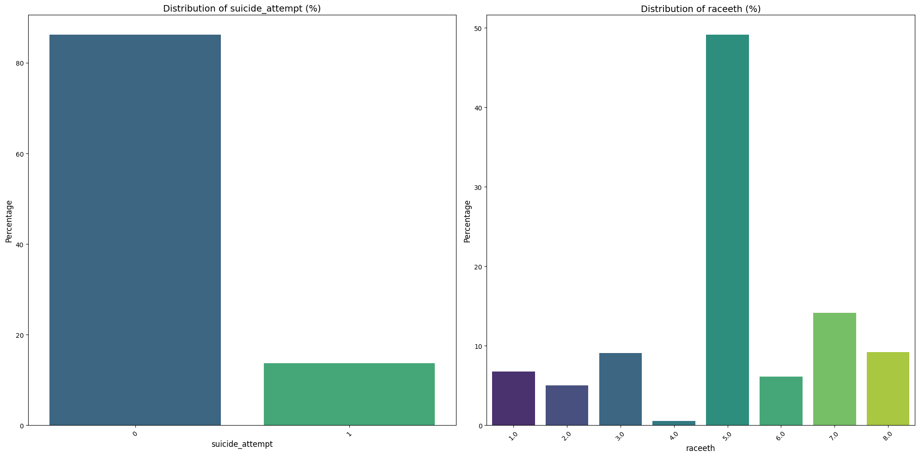
Exploratory Data Analysis
Legend
suicide_attempt
0=No
1=Yes
raceeth (race and ethnicity combined)
1=Indian/Alaska Native
2=Asian
3=Black or African American
4=Native Hawaiian/Other PI
5=White
6=Hispanic/Latino
7=Multiple - Hispanic
8=Multiple - Non-Hispanic
Notes:
suicide_attempt
0 17341
1 2762
raceeth
5.0 49.156236
7.0 14.118482
8.0 9.192723
3.0 9.076167
1.0 6.760249
6.0 6.121725
2.0 5.042315
4.0 0.532104

Slide 10
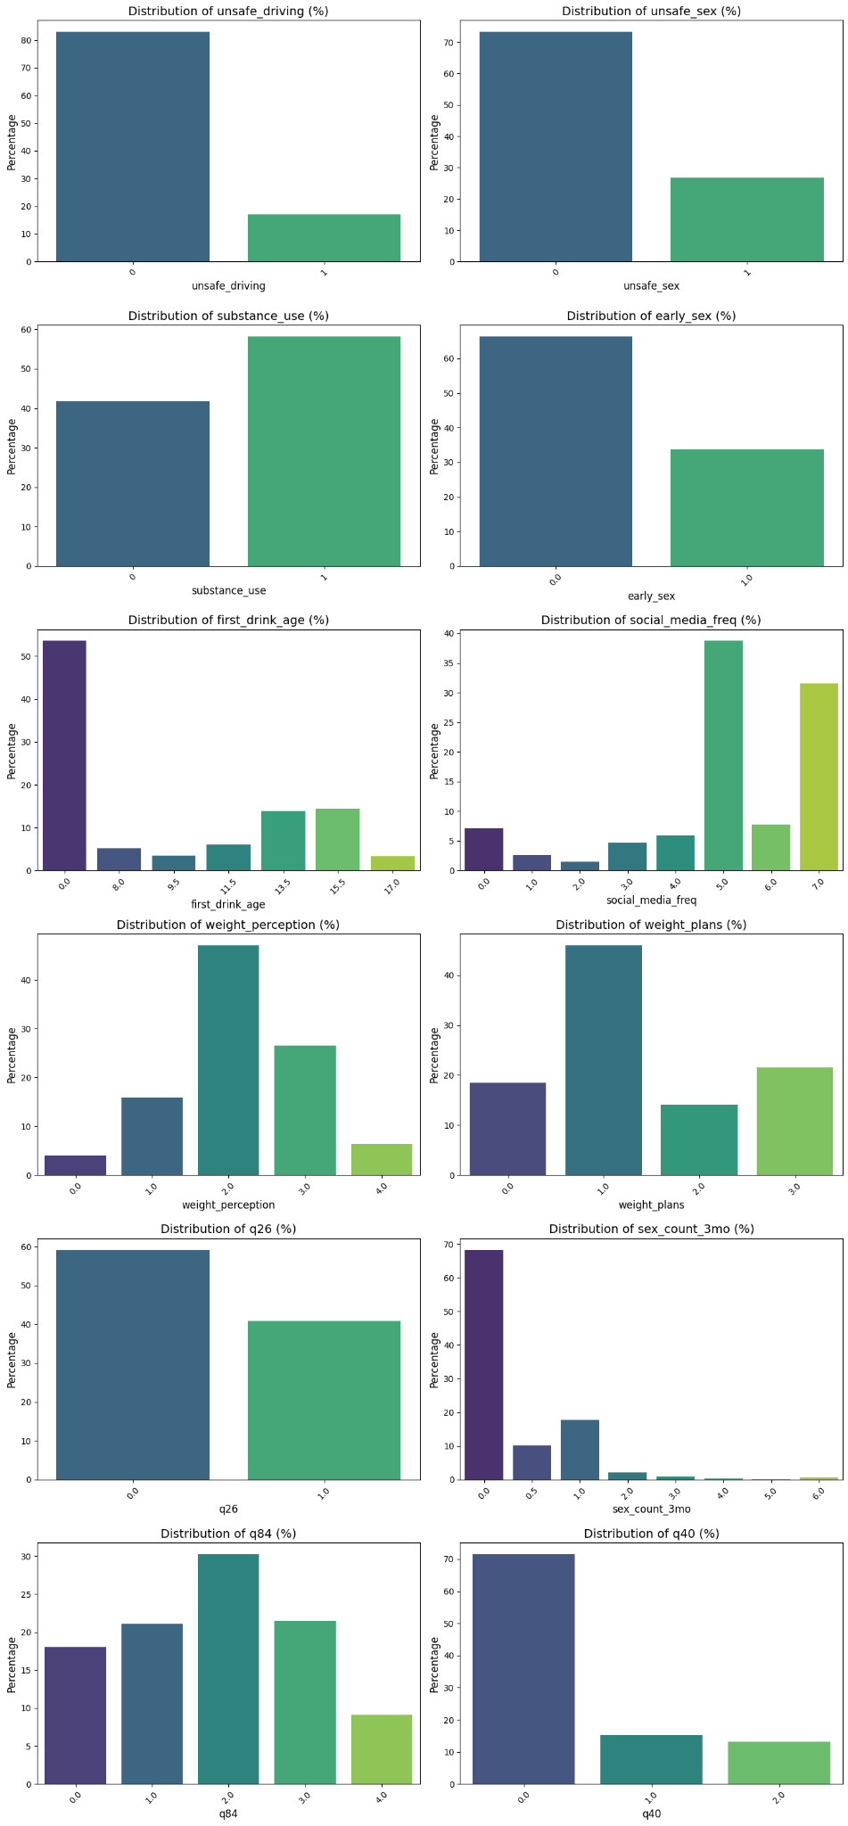

Slide 11
weight_perception
0=very underweight
1=slightly underweight
2=about the right weight
3=slightly overweight
4=slightly overweight
5=very overweight
weight_plans
0=not trying to do anything about my weight
1=lose weight
2=gain weight
3=stay the same weight

Slide 13
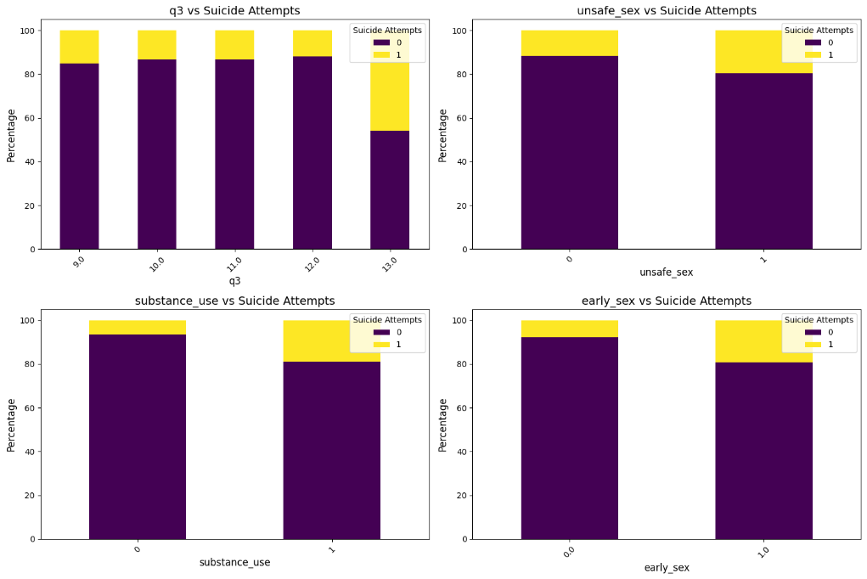

Slide 14
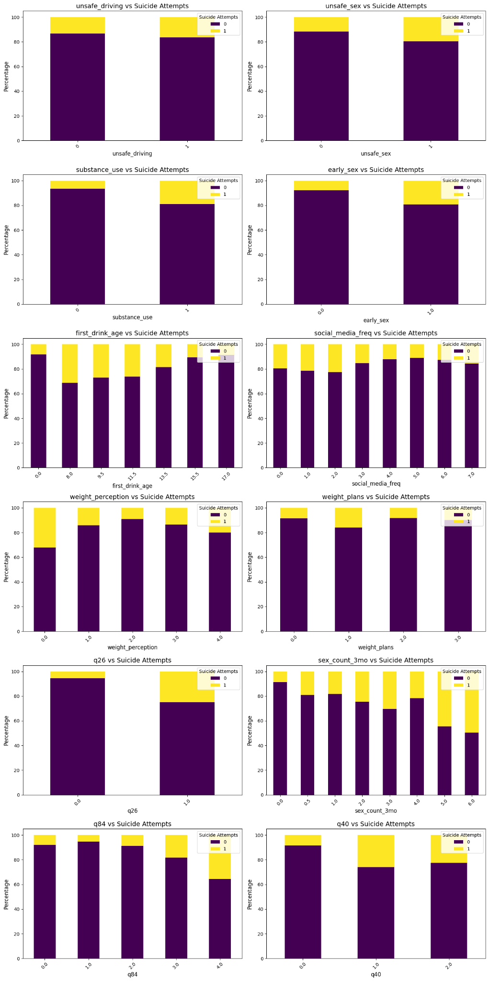

Slide 16
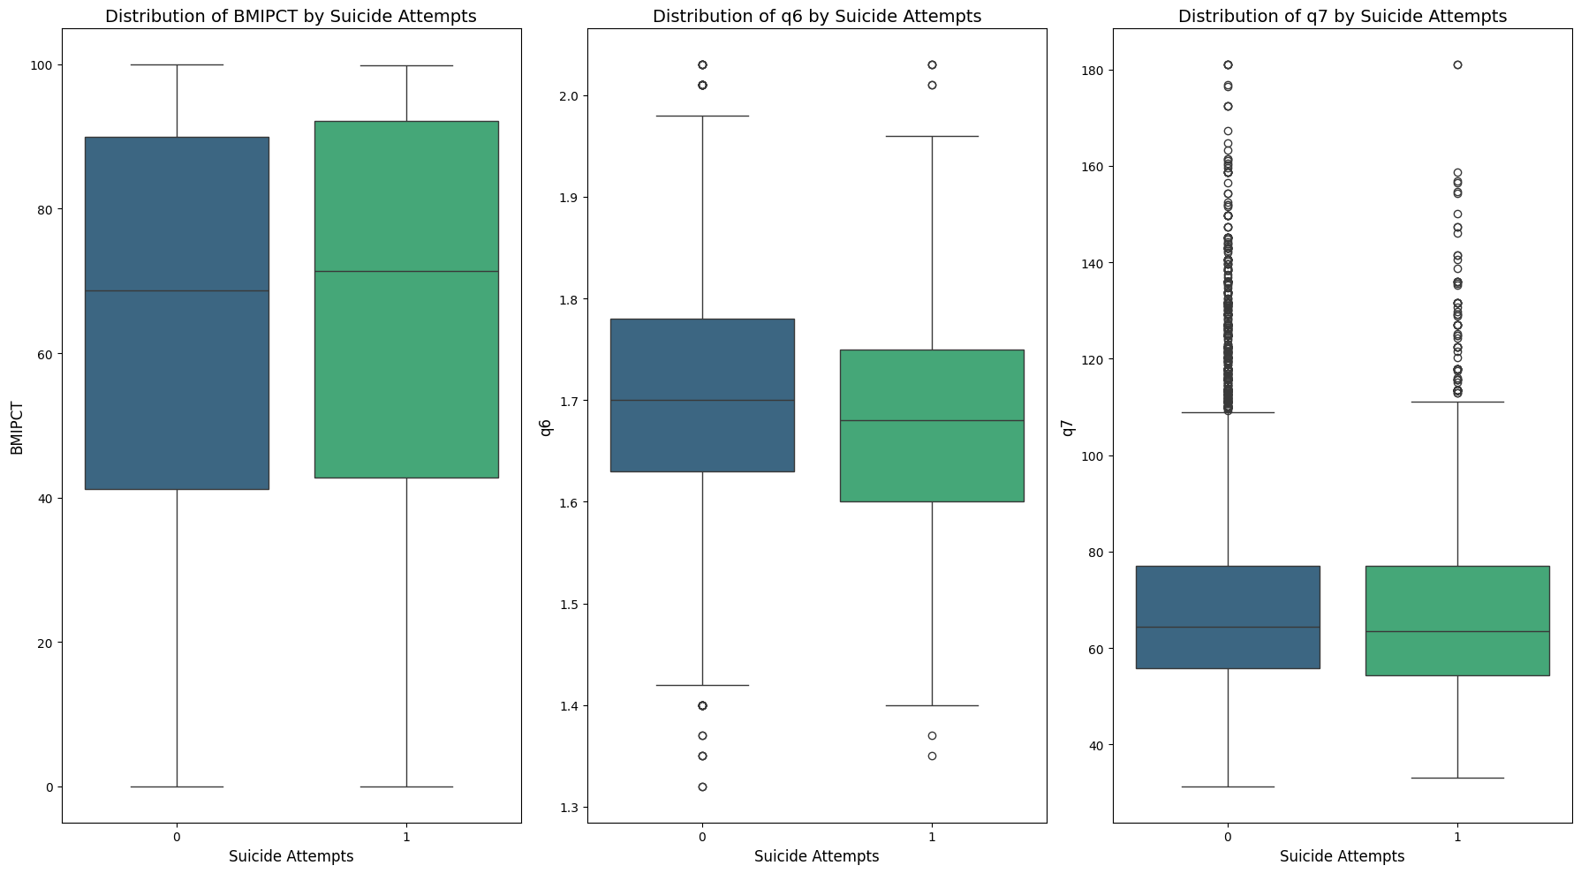

Slide 17
Feature engineering
1. Binning
2. One-hot Encoding
3. Missing Value Imputation(Using decision Tree)
4. Solving Collinearity and Multicollinearity

Slide 18
Modeling
KNN
LDA
Logistic Regression Model
L1/L2 penalty
Decision Tree & Ensemble Models
- Decision Tree
- XGBoost
- Random Forest

Slide 19
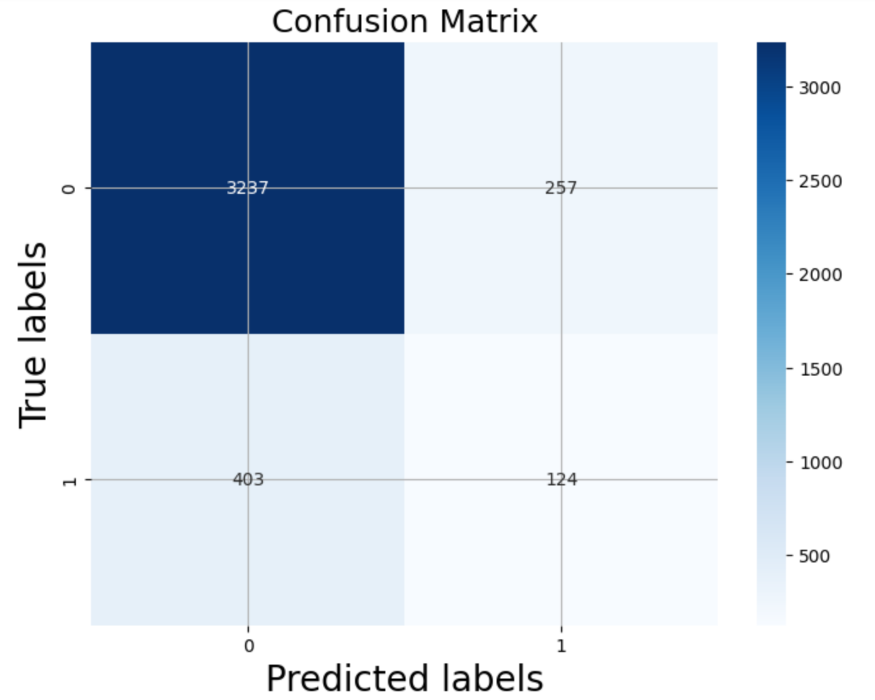
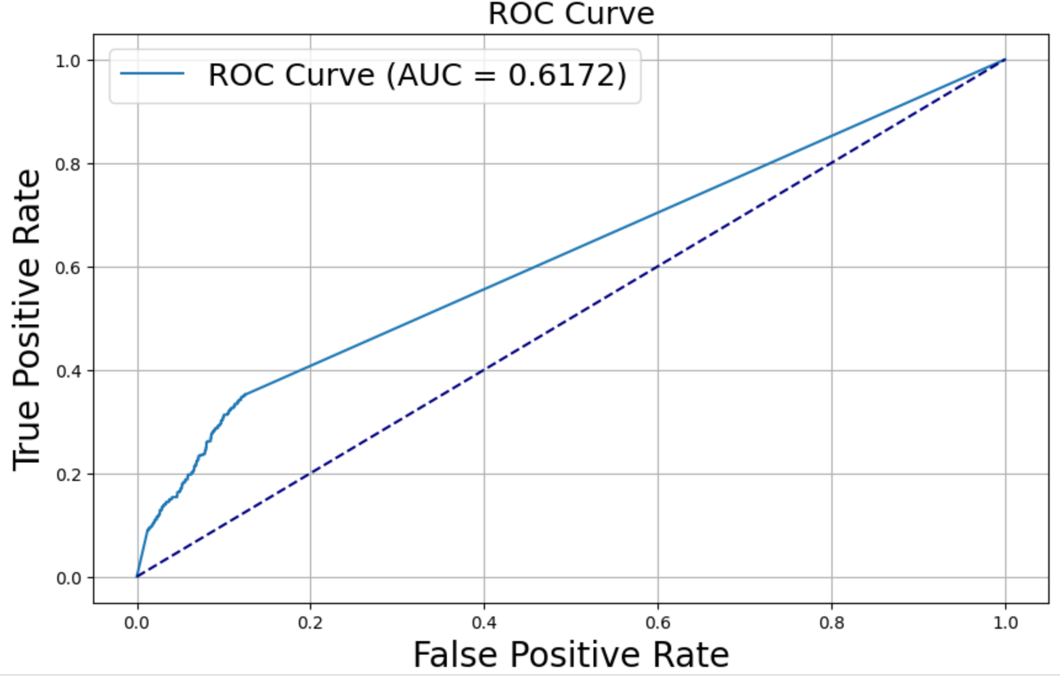
KNN
Accuracy：0.84

Slide 20
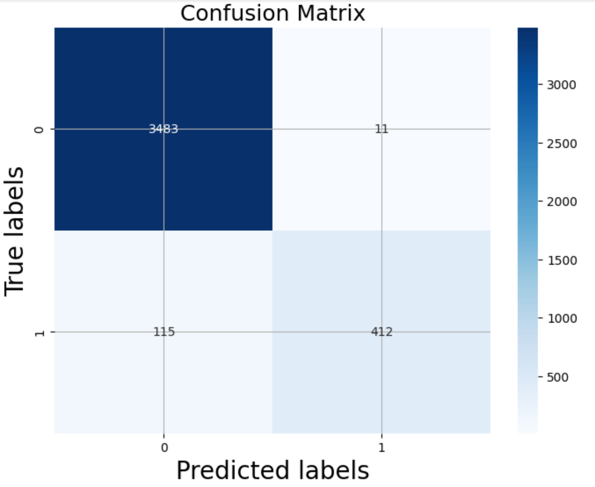
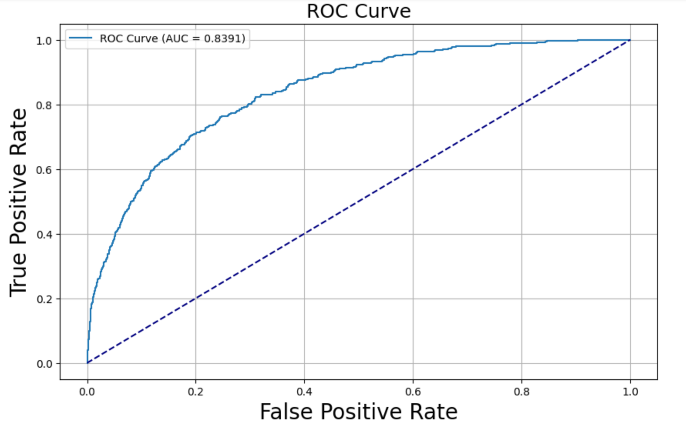
LDA
Accuracy：0.88

Slide 21
Logistic Regression Model
-Assumption of logistic Regression
-Binary dependent variable/independence of errors/ absence of multicollinearity/no strong outliers
-Hyperparameter tuning
-Comparison of penalty types(None,L1,L2)
C=0.01
-Results

Slide 22
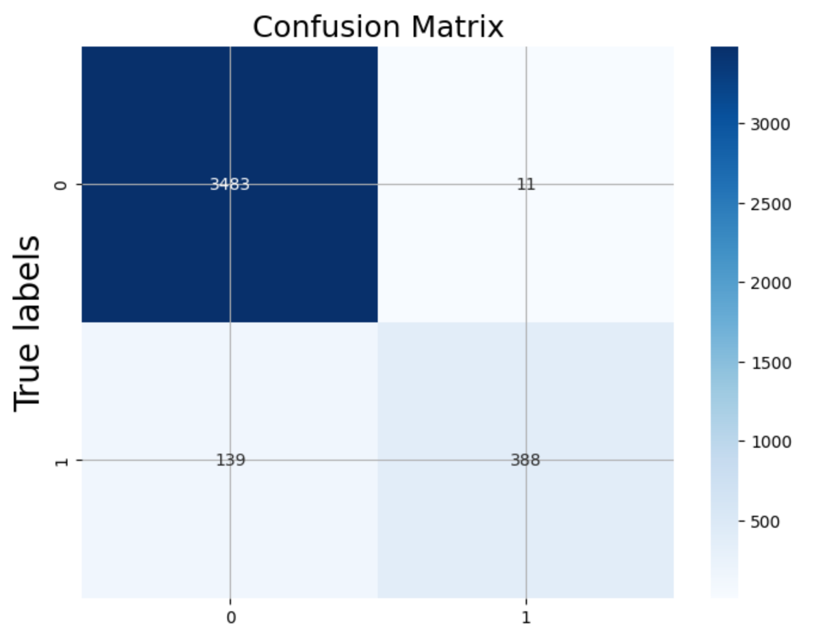
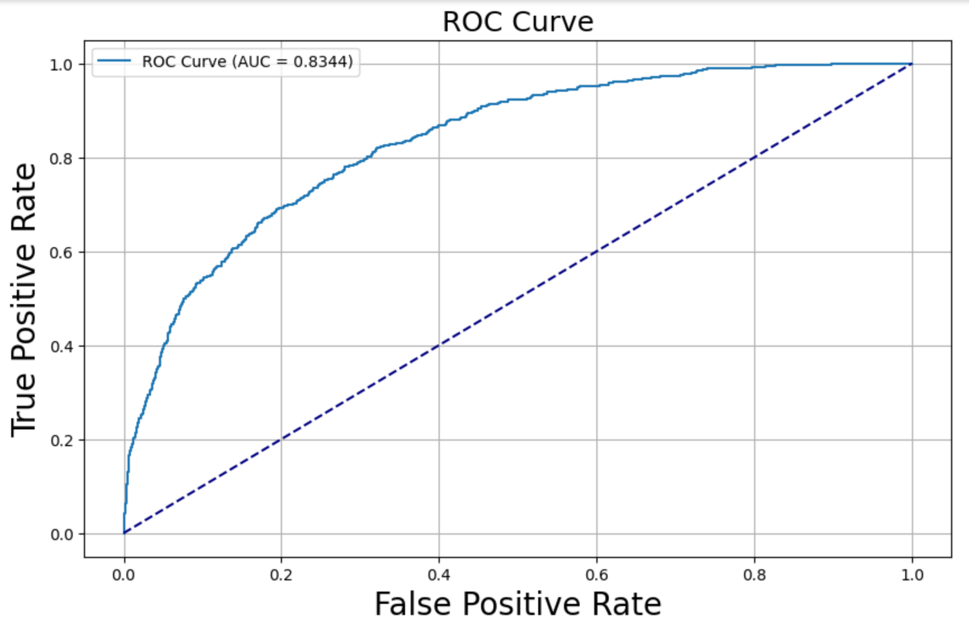
Logistic Regression-L1
Accuracy：0.88

Slide 23
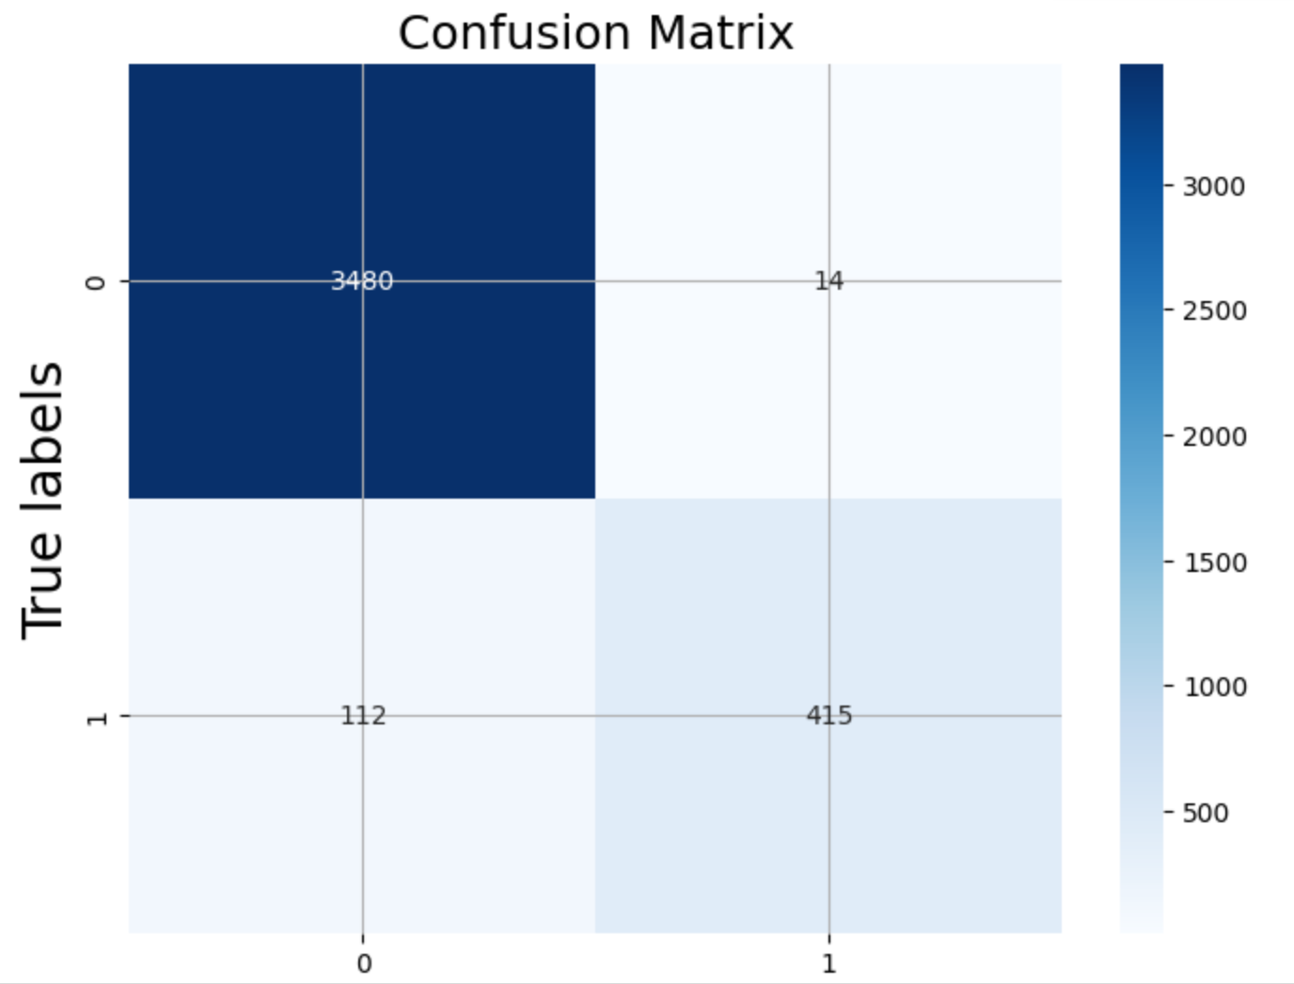
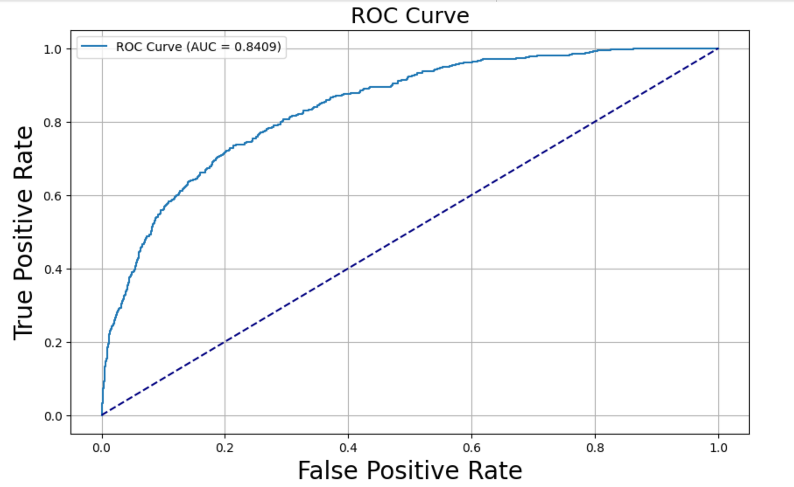
Logistic Regression-L2
Accuracy：
Accuracy：0.88

Slide 24
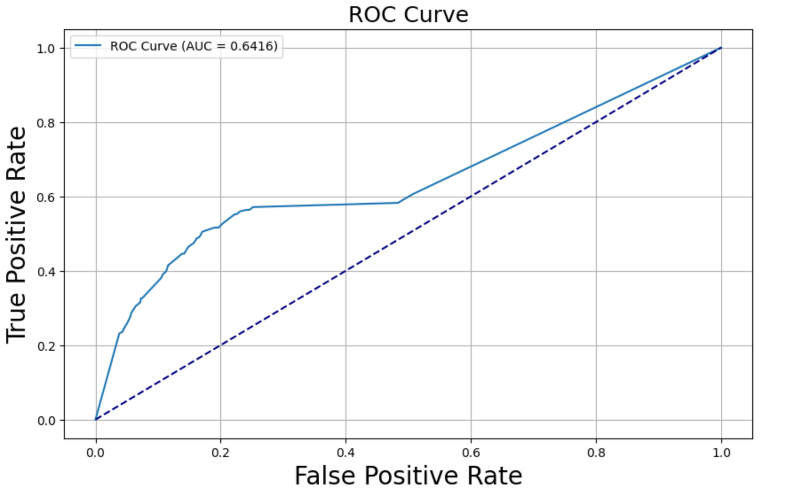
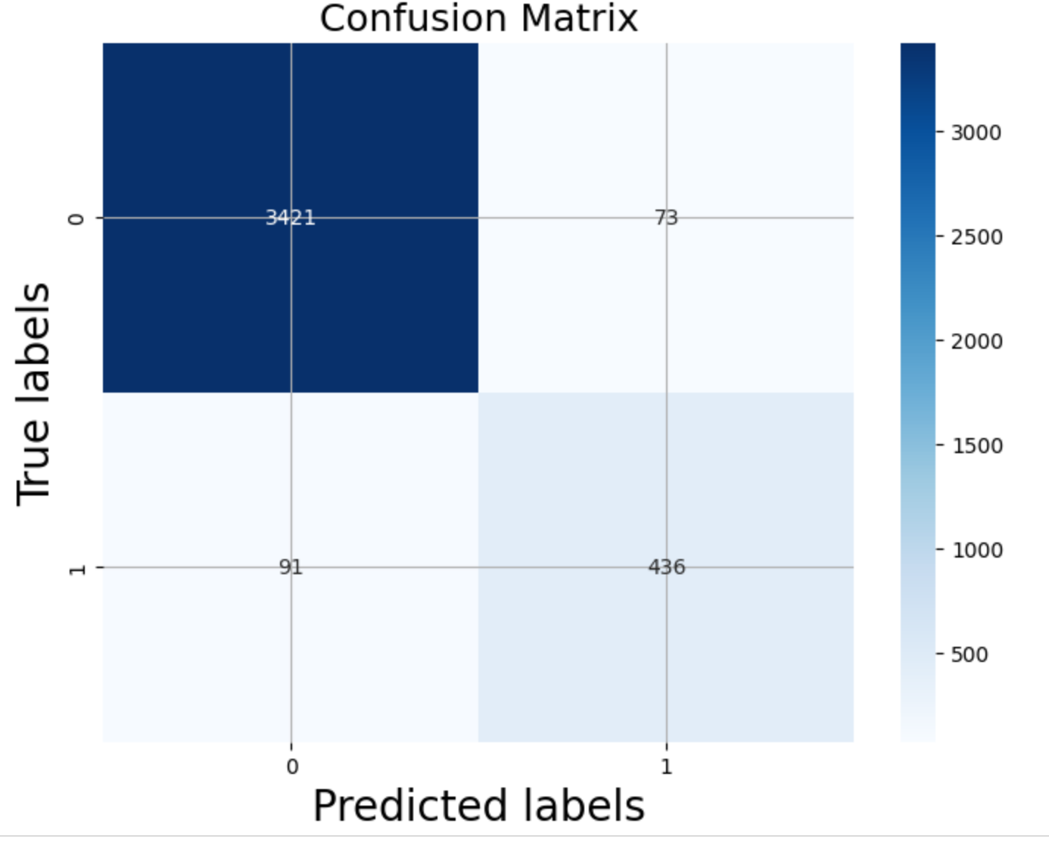
Decision Tree
Accuracy：0.85
Max depth: 20, min_samples_leaf: 2, min_samples_split: 10

Slide 25

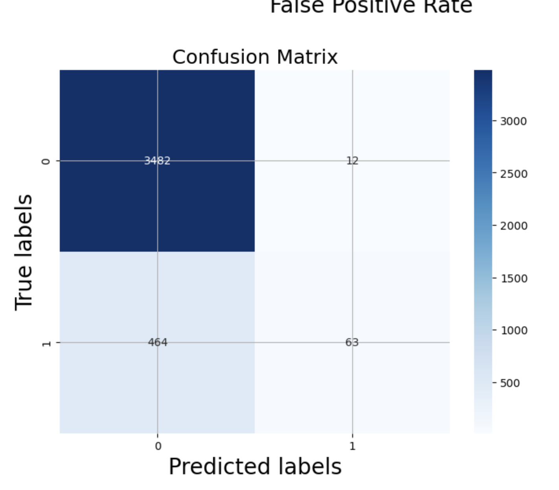
XGBoost
Accuracy：0.92

Slide 26
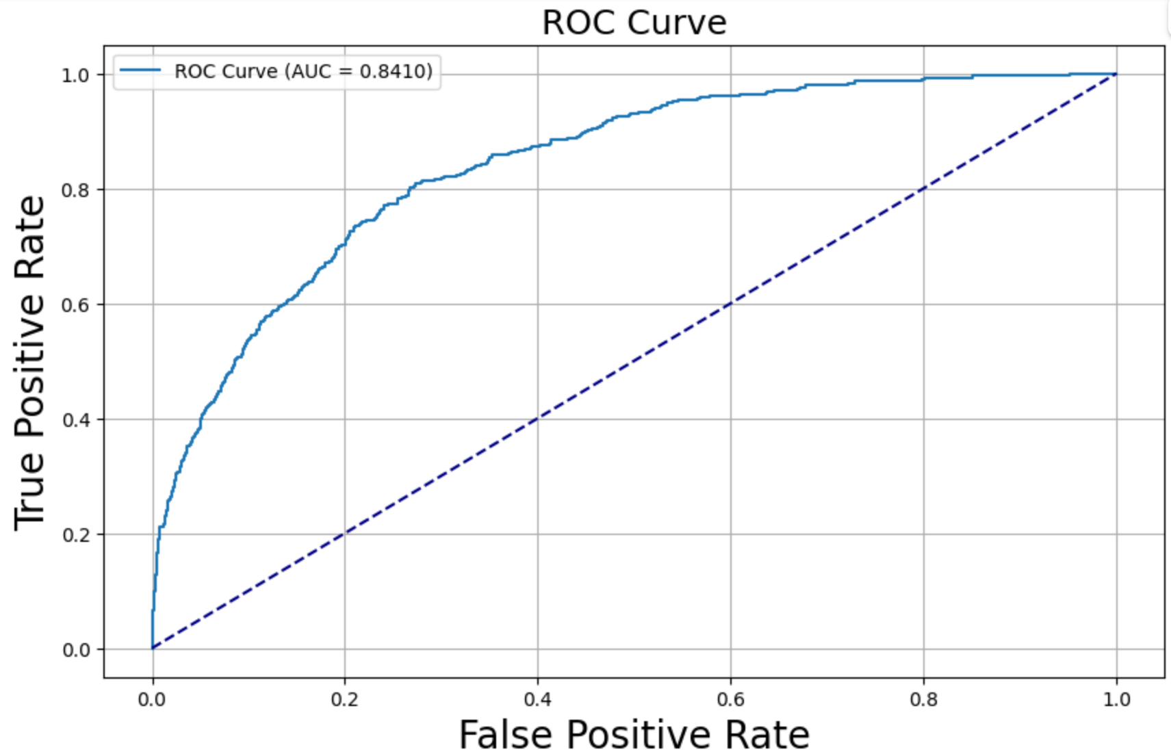
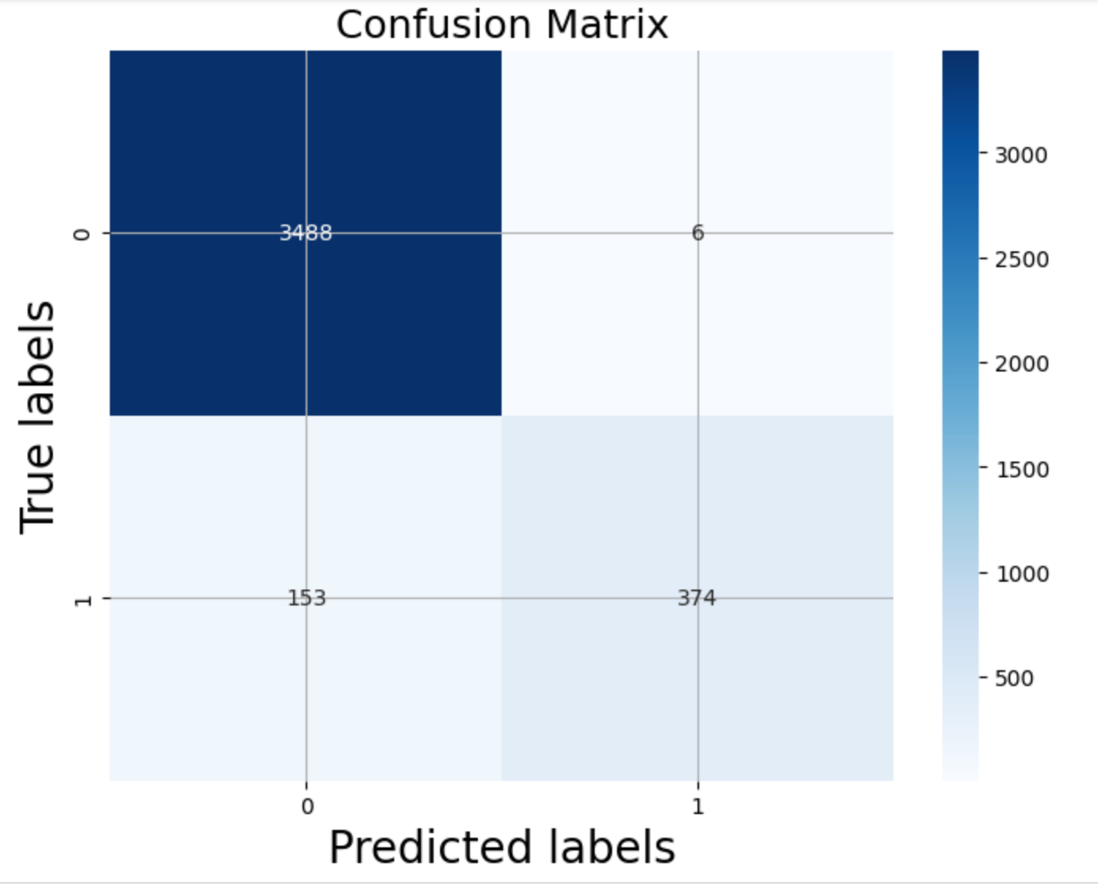
Random Forest
Max depth: 10, min_samples_leaf: 2, min_samples_split: 5, n_estimators: 100
Accuracy：

Slide 27
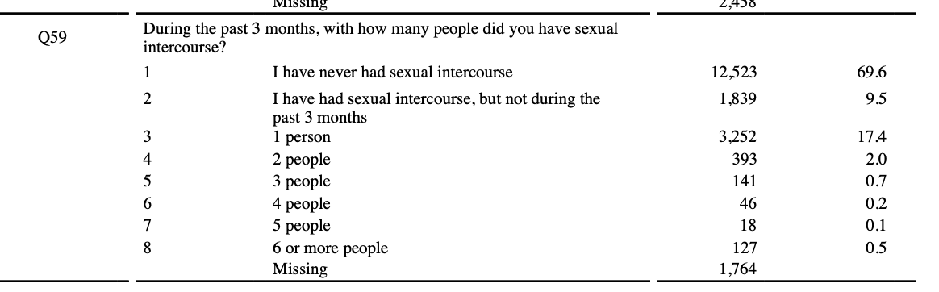
Feature Importance & Conclusion
Positive:
Feeling Hopeless/Depression/Mental health/Unwilling sex1.0/physical sexual hurt/unwanted sexual intercourse
negative：Drink age 15/First drink age/weight loss plan/Early sex

Slide 28
Reference
Penn, Joseph V., Christianne L. Esposito, Leah E. Schaeffer, Gregory K. Fritz, and Anthony Spirito. "Suicide attempts and self-mutilative behavior in a juvenile
correctional facility." Journal of the American Academy of Child & Adolescent Psychiatry 42, no. 7 (2003): 762-769.https://www.sciencedirect.com/science/article/pii/S0890856709609758?casa_token=R41FYXR26mYAAAAA:wCa02ucd1SgNCvr4A8azySxI5dzv6In8vcgFJK7EC4gMk2G8gOW_z_nume2gUAI8ZhzM2LogYA
Cañizares, Catalina, Mark J. Macgowan, Miriam Potocky, Hui Huang, Jeremy W. Pettit, and Raymond R. Balise. "Identifying Predictors of Adolescent Suicide
Attempts: A Comparative Machine Learning Study." (2025).
Cash, S. J., & Bridge, J. A. (2009). Epidemiology of youth suicide and suicidal behavior. Current Opinion in Pediatrics, 21(5), 613-619.
https://journals.lww.com/co-pediatrics/FullText/2009/10000/Epidemiology_of_youth_suicide_and_suicidal.11.aspx
Centers for Disease Control and Prevention. "School Connectedness Helps Students Thrive." Morbidity and Mortality Weekly Report Supplement 72, no. 1 (2023):
34-42. https://www.cdc.gov/mmwr/volumes/72/su/su7201a2.htm?s_cid=su7201a2_w.
Centers for Disease Control and Prevention. "Parental Monitoring and Risk Behaviors and Experiences Among High School Students." Morbidity and Mortality
Weekly Report Supplement 72, no. 1 (2023): 85-91. https://www.cdc.gov/mmwr/volumes/72/su/su7201a5.htm.
Centers for Disease Control and Prevention. "Overview and Methods for the Youth Risk Behavior Surveillance System (YRBSS)—United States, 2023." Morbidity
and Mortality Weekly Report Supplement 73, no. 4 (2023): 1-12. https://www.cdc.gov/mmwr/volumes/73/su/su7304a1.htm.
Centers for Disease Control and Prevention. 2023. “Youth Risk Behavior Surveillance System (YRBS) Data.” Accessed March 10, 2025.
https://www.cdc.gov/yrbs/data/index.html.
Disparities and Trends in Middle School Students’ Suicidal Thoughts and Behaviors: Results From the Youth Risk Behavior Survey, 2015–2019.
Li, Xiaozhi, Guijun Chi, Alyx Taylor, Si-Tong Chen, Aamir R. Memon, Yanjie Zhang, Yagang Song, Jinming Li, Xun Luo, and Liye Zou. "Lifestyle behaviors and
suicide-related behaviors in adolescents: cross-sectional study using the 2019 YRBS data." Frontiers in public health 9 (2021):
766972.https://www.frontiersin.org/journals/public-health/articles/10.3389/fpubh.2021.766972/full.
Lindsey, M. A., Sheftall, A. H., Xiao, Y., & Joe, S. (2019). Trends of suicidal behaviors among high school students in the United States: 1991–2017. Pediatrics,
144(5), e20191187. https://publications.aap.org/pediatrics/article/144/5/e20191187/76987/Trends-of-Suicidal-Behaviors-Among-High-School
The Impact of the COVID-19 Pandemic on Adolescents: An Opportunity to Build Resilient Systems.
Trends in Depressive Symptoms and Suicidality: Youth Risk Behavior Survey 2009–2017.

Slide 29

Let’s Have A Great Day!

